Slide 1

Exam AZ-500: Microsoft Azure Security Technologies Crash Course
Tim Warner

Slide 2


Tim Warner
Based in Nashville, TN, US
Central time zone
MCT, MVP
Twitter: @TechTrainerTim
Badge: TechTrainerTim.com

Slide 3
Course Materials
timw.info/az500

Slide 4
Session 1 of 2 Learning Goals
Introduction
Manage identity and access
Manage security operations

Slide 5
Session 2 of 2 Learning Goals
Sweep up the shavings
Azure Policy & Microsoft Defender for Cloud
Implement platform protection
VMs & networking
Secure data and applications
Data encryption

Slide 6
Setting Expectations
Let's avoid slide show fatigue
We'll learn by doing – at least 80 percent demo
Case study/scenario approach
10-minute break at midpoint
I’m here to answer your questions – take advantage of this!
Use the Q&A panel

Slide 7

Session Recordings

Slide 8

Session Recordings

Slide 9

Session Recordings

Slide 10


Mobile Browser: learning.oreilly.com

Slide 11



O'Reilly Mobile App

Slide 12
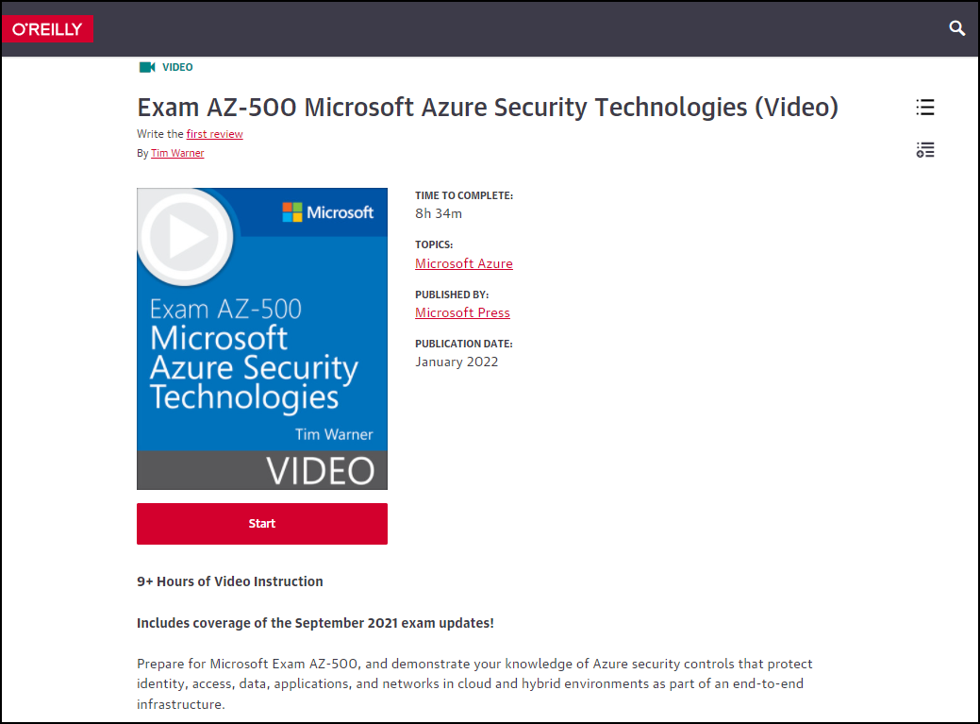
AZ-500 Video Course (MS Press)
timw.info/msp500

Slide 13
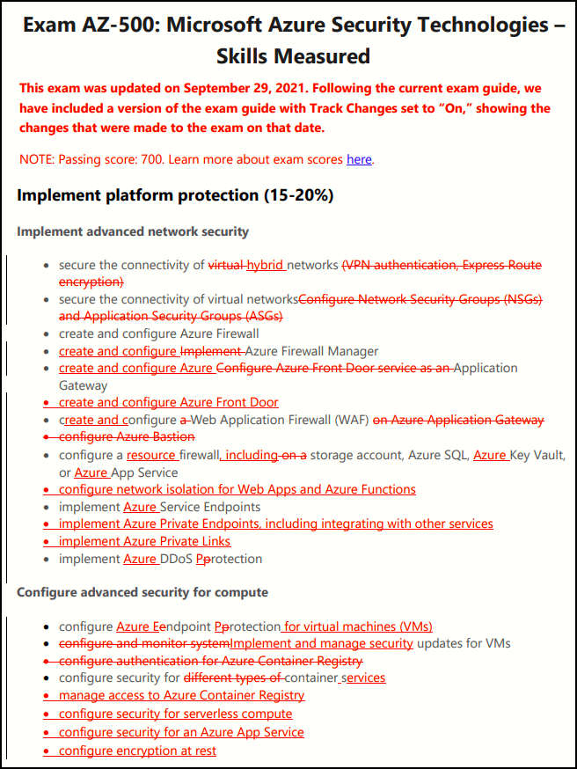
AZ-500 Changes: September 29, 2021

Slide 14
Certification Renewal
Associate and Expert certs are valid for one year
Credential will always be on your MS transcript
At six-month mark you’ll be asked to renew
Free online assessment at Microsoft Learn
Renewal extends your certification for 365 from original achievement date

Slide 15
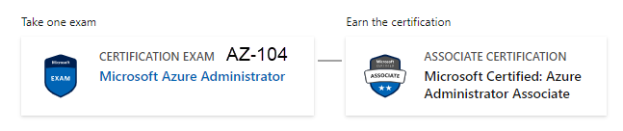
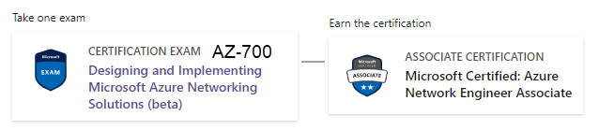

Related Certifications

Slide 16

Tim's "Tower Bridge" Certification Study Model

Slide 17
Thank you!
Course materials: timw.info/az500
Twitter: @TechTrainerTim
Work: timw.info/ps
Web: TechTrainerTim.com

Slide 18
Manage Identity and Access

Slide 19
AAA Model
Authentication
Identity verification
Authorization
Access scope
Accounting
Successful and failed AuthN and AuthZ attempts

Slide 20
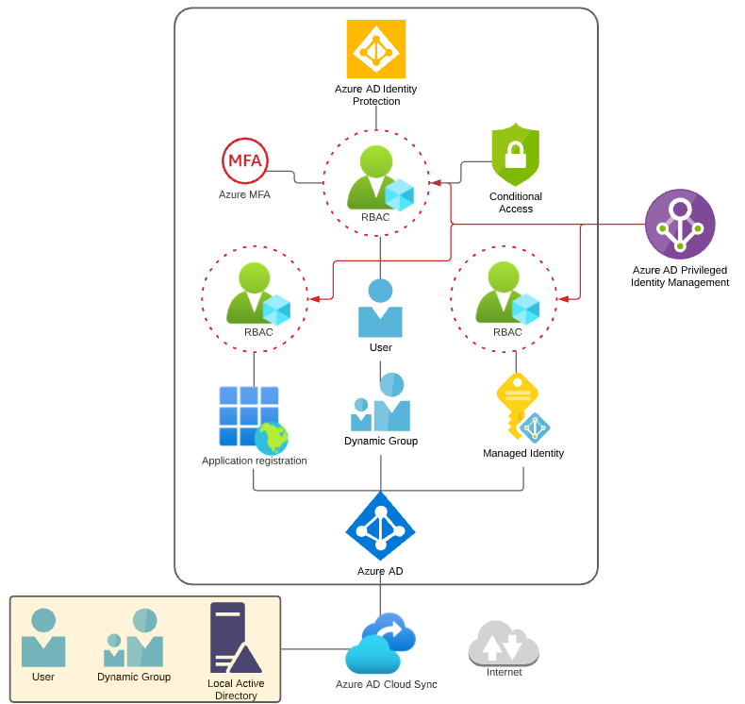
Identity and Access Scenario

Slide 21

Tenant vs. Subscription

Slide 22

Hybrid Identity

Slide 23

Azure Management Scopes
/ Tenant Root

Slide 24
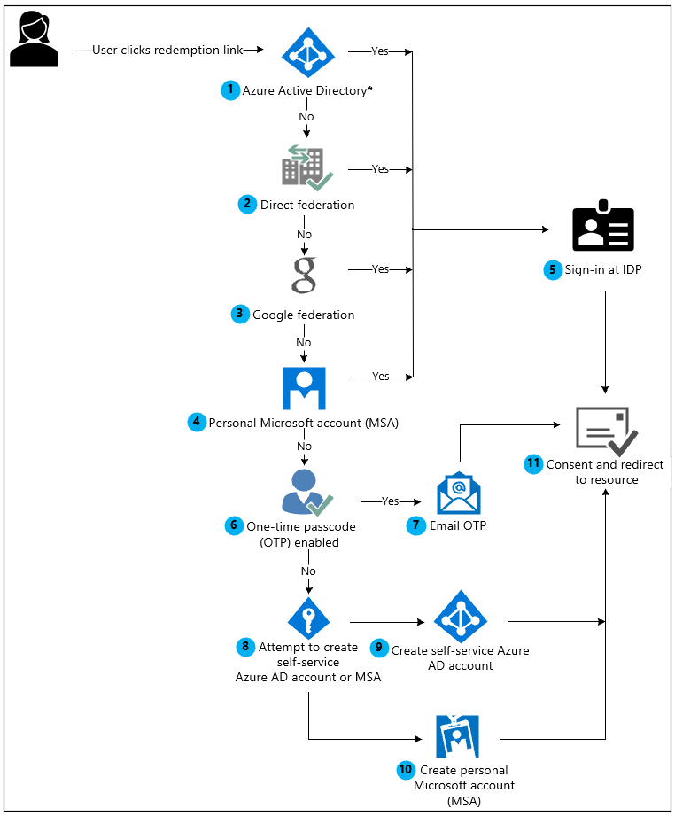
Azure AD B2B Collaboration

Slide 25
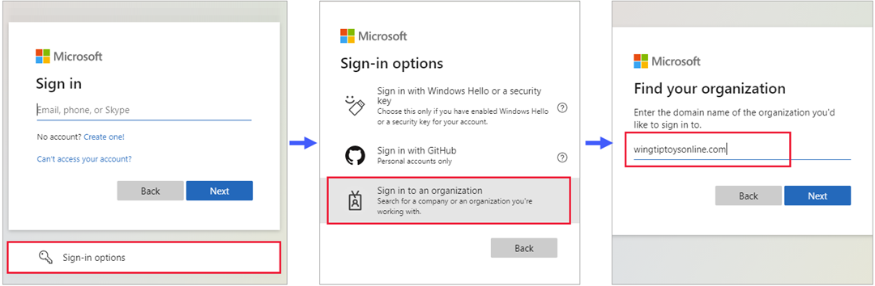
Azure AD B2B Collaboration

Slide 26
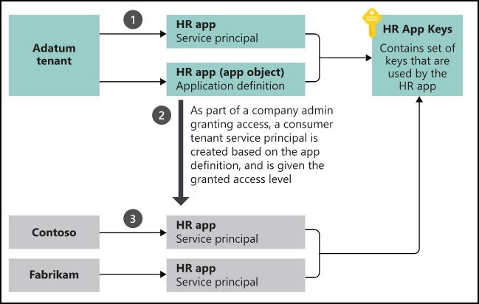
App Registrations & Service Principals

Slide 27


Azure AD B2C

Slide 28

Azure AD Domain Services

Slide 29
Azure AD Connect

Slide 30

Passthrough Authentication

Slide 31

ADFS Federation

Slide 32
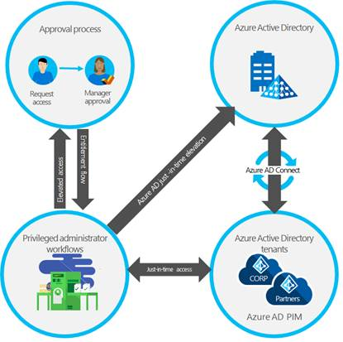
Azure AD PIM

Slide 33
Implement Platform Protection

Slide 34
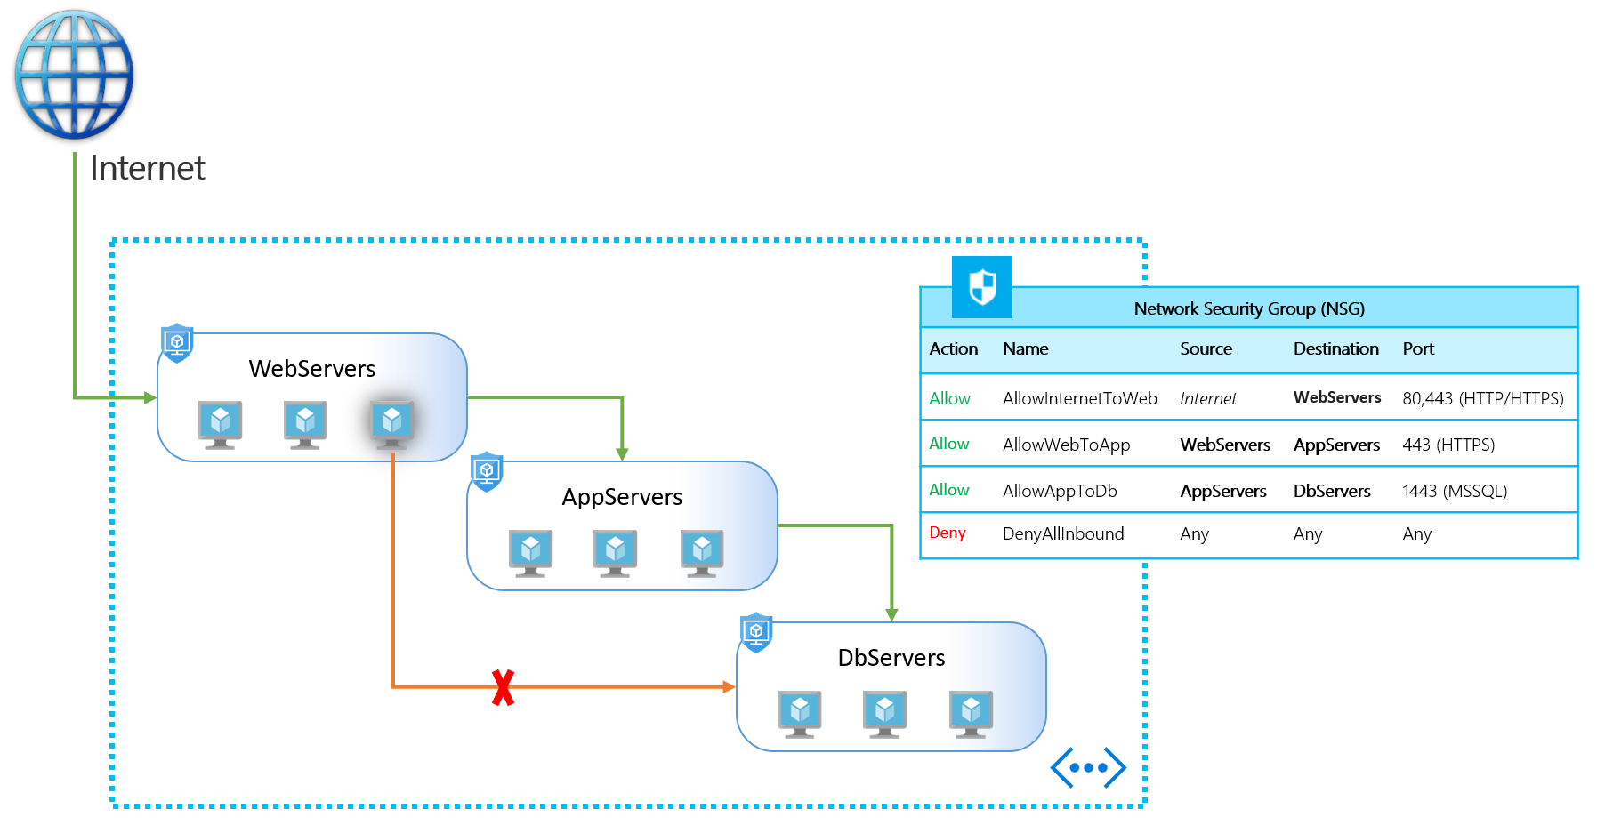
NSGs and ASGs

Slide 35

Multi-Region High Availability

Slide 36

Multi-Region High Availability

Slide 37
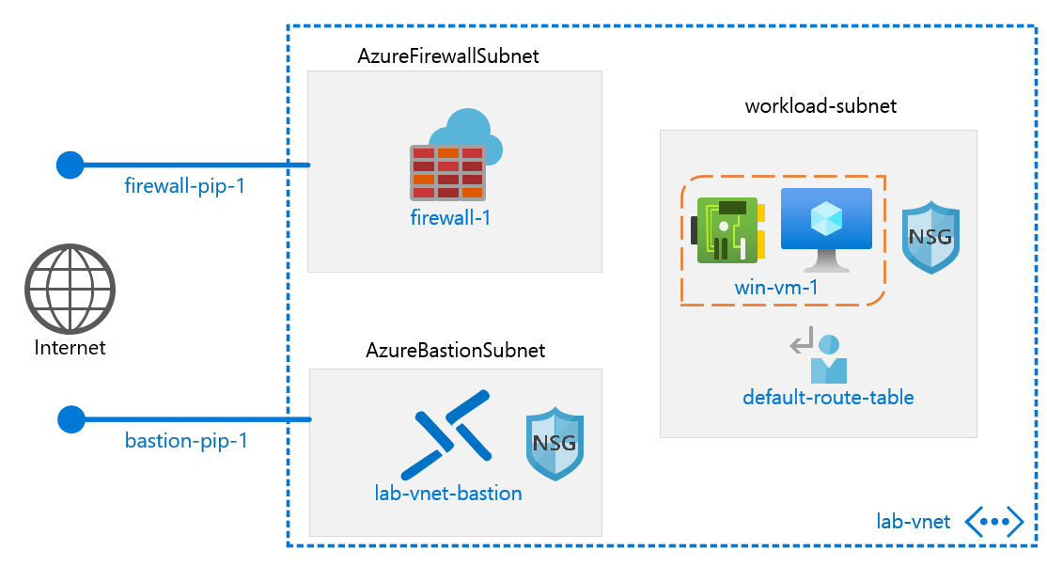
Azure Firewall

Slide 38
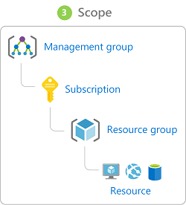
Management Scopes
/ Tenant Root

Slide 39

Service endpoints

Slide 40
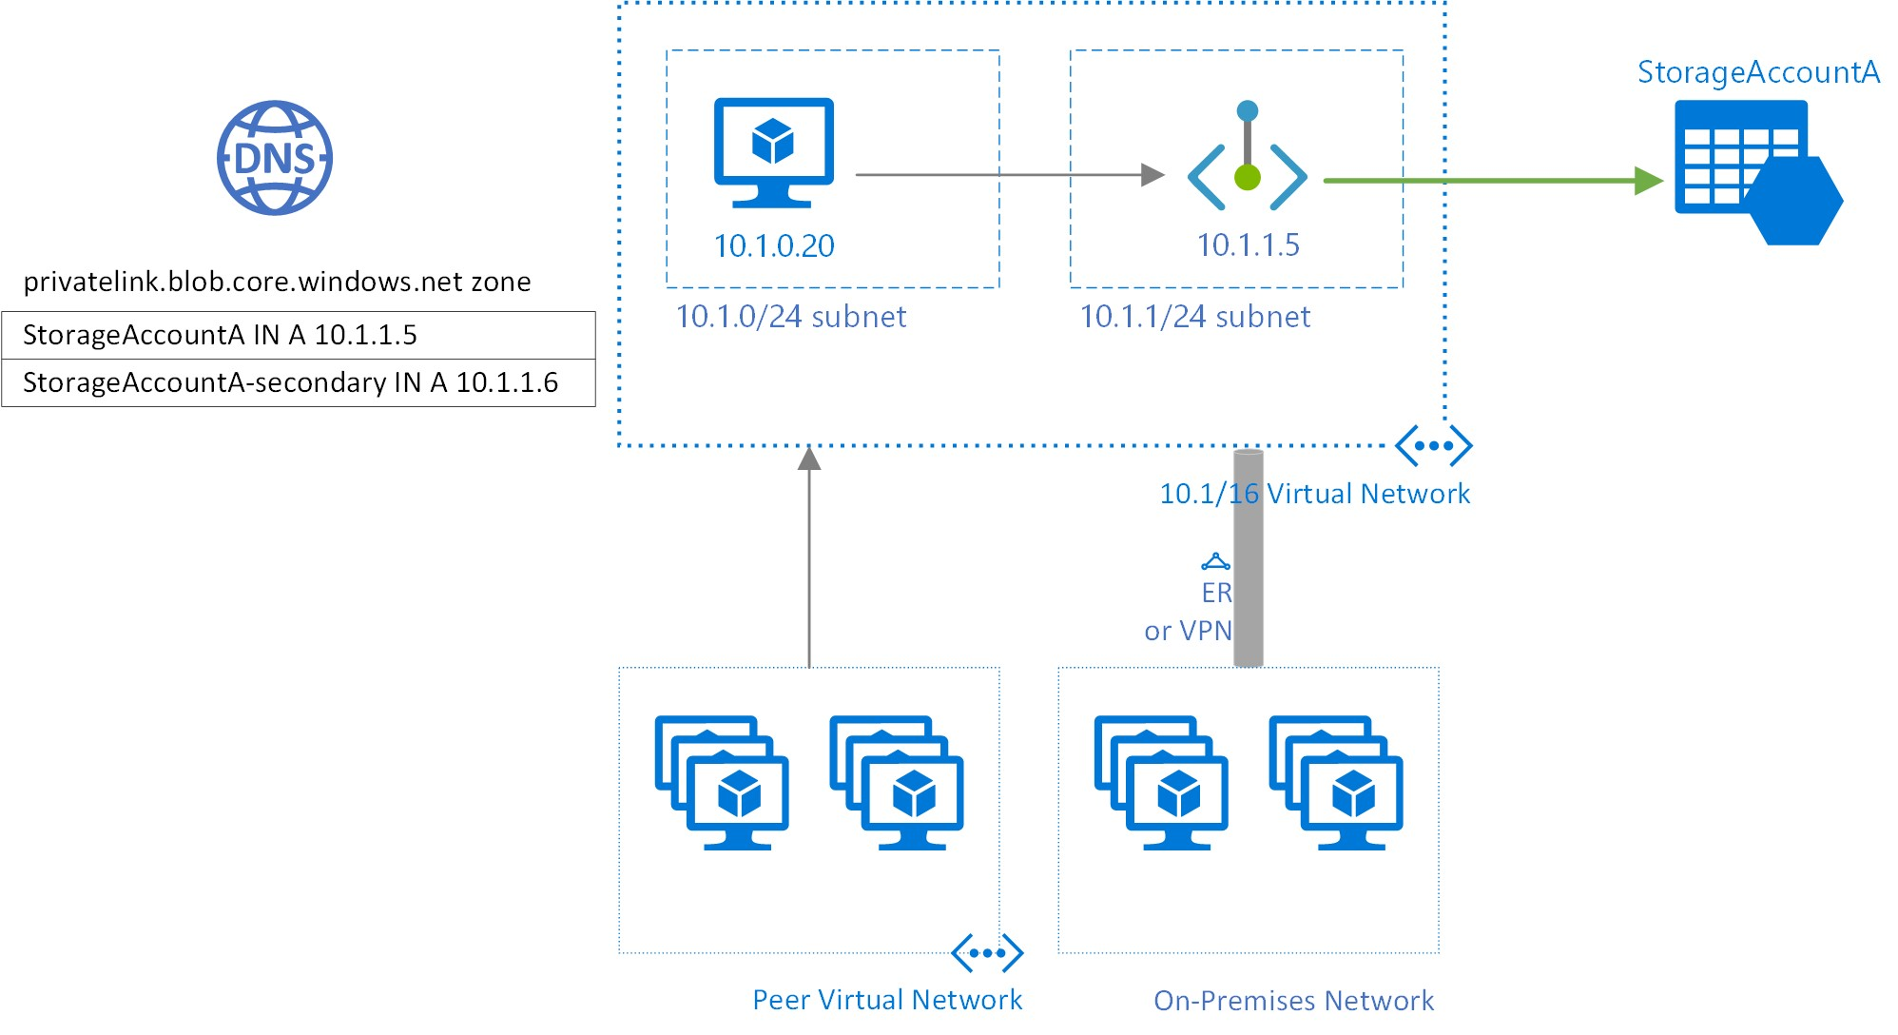
Private endpoints

Slide 41
Compute and Networking

Slide 42
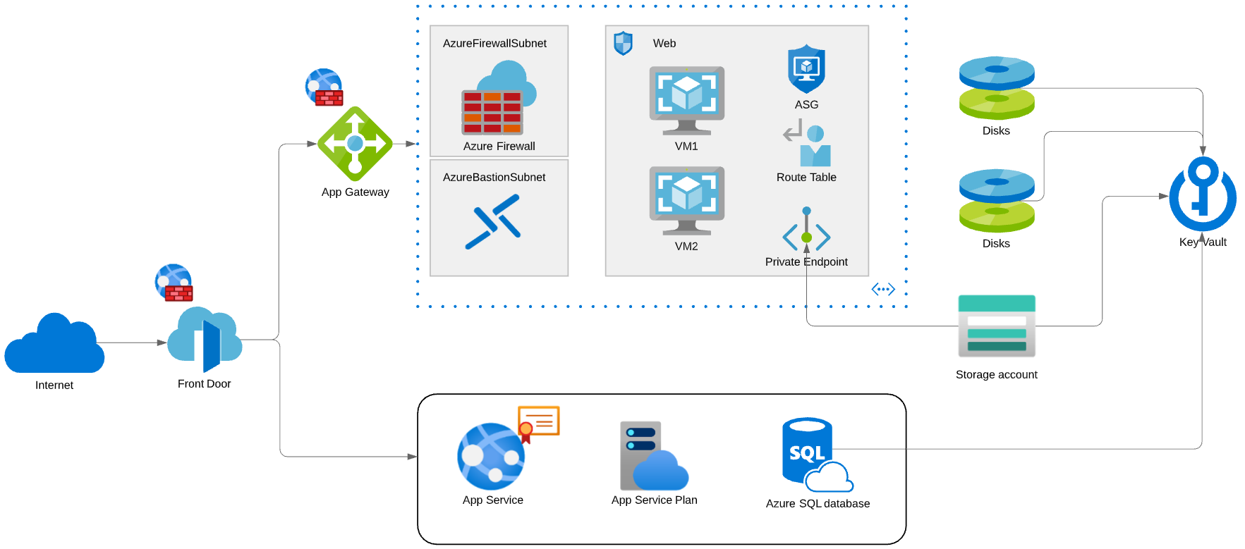
Compute and Networking Scenario

Slide 43
Manage Security Operations

Slide 44
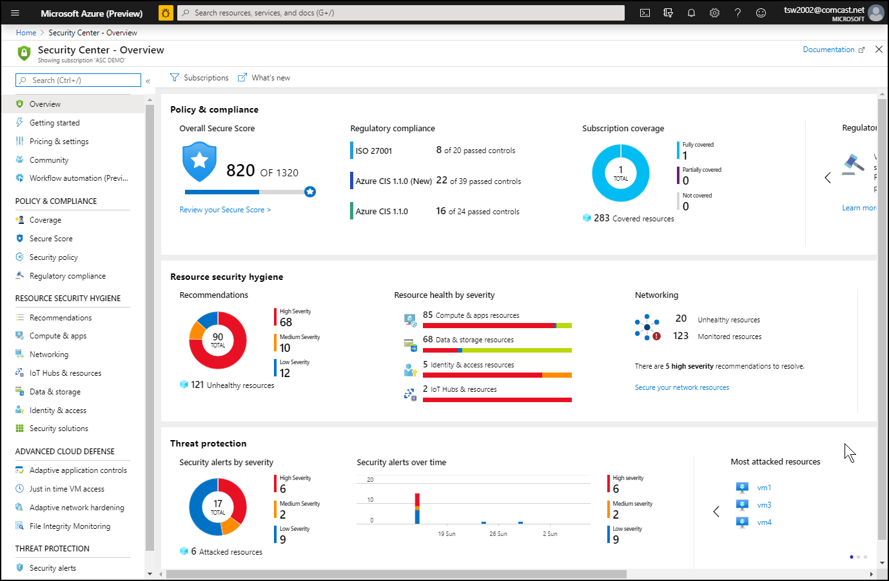
Azure Security Center

Slide 45
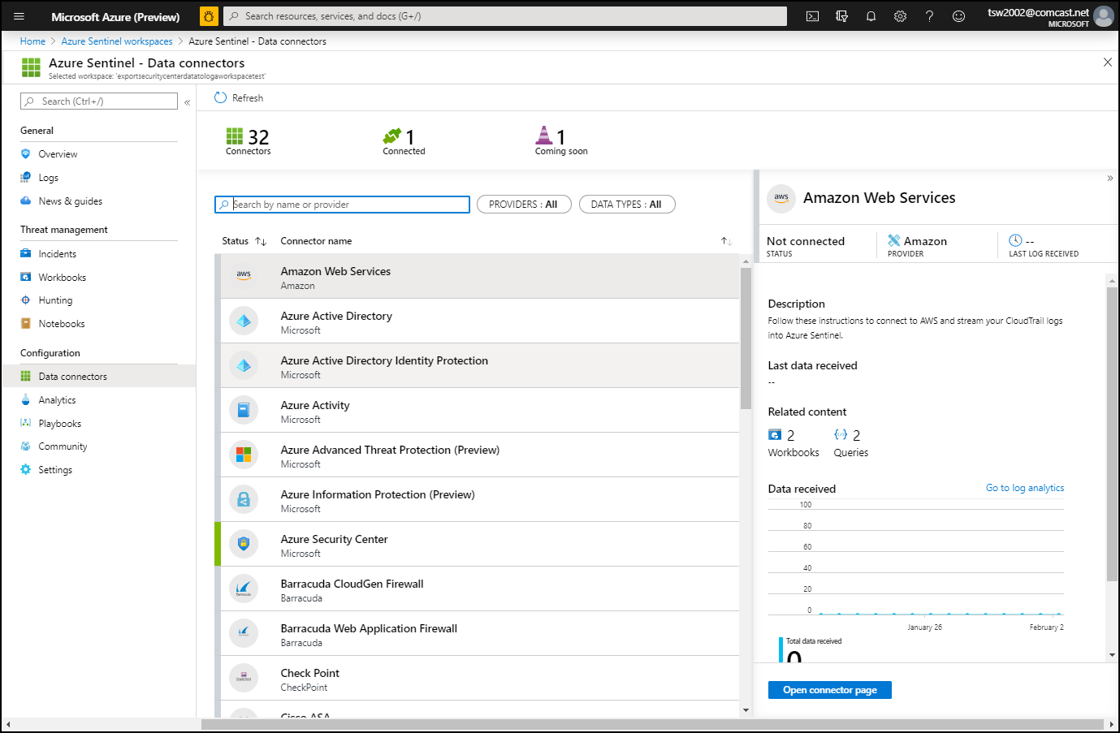
Azure Sentinel

Slide 46
Secure Data and Applications

Slide 47
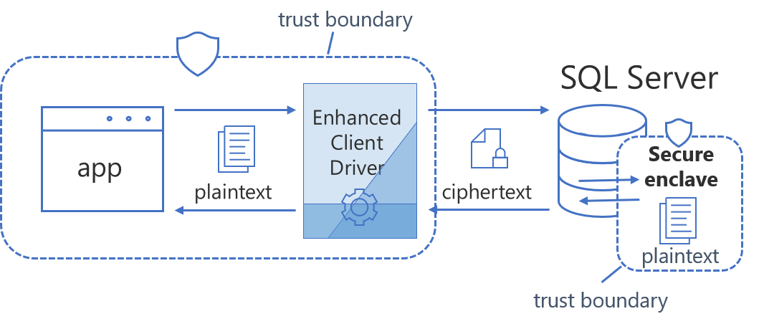
Always Encrypted

Slide 48
Security Operations

Slide 49
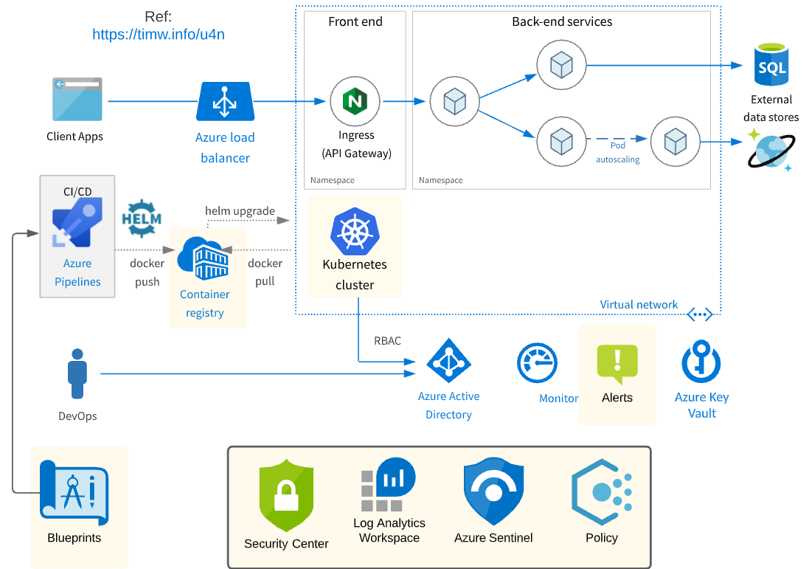
Security Operations Scenario

Slide 50
Exam AZ-500 Item Types

Slide 51

Single Answer Multiple Choice

Slide 52

Multiple Answer Multiple Choice

Slide 53
Repeated Scenario
You need to move an Azure VM to another hardware host.
Solution: You redeploy the VM.
Does this solution meet the goal?
Yes
No

Slide 54
Repeated Scenario
You need to move an Azure VM to another hardware host.
Solution: You enable boot diagnostics.
Does this solution meet the goal?
Yes
No

Slide 55

Select and Place

Slide 56

Build List and Reorder

Slide 57

Active Screen

Slide 58

Case Study

Slide 59






Performance-Based Testing

Slide 60
Microsoft Online Testing

Slide 61
Microsoft Online Testing Process
timw.info/online

Slide 62

Microsoft Online Testing Process

Slide 63

Microsoft Online Testing Process

Slide 64

Microsoft Online Testing Process

Slide 65

Microsoft Online Testing Process

Slide 66

Microsoft Online Testing Process

Slide 67

Microsoft Online Testing Process

Slide 68

Microsoft Online Testing Process

Slide 69
AZ-500 Exam Strategy
Focus your skills accordingly:
60 percent Azure portal
20 percent Azure PowerShell
10 percent Azure CLI
10 percent KQL
Azure AD PIM all day long
Expect performance-based labs, but be happy if you don't see 'em

Slide 70
Parting Advice
Check out my YouTube (timw.info)
Online testing
Cert item strategy
AZ-500 study guide
Invest in Whizlabs or MeasureUp
Register for your exam ASAP!

Slide 71
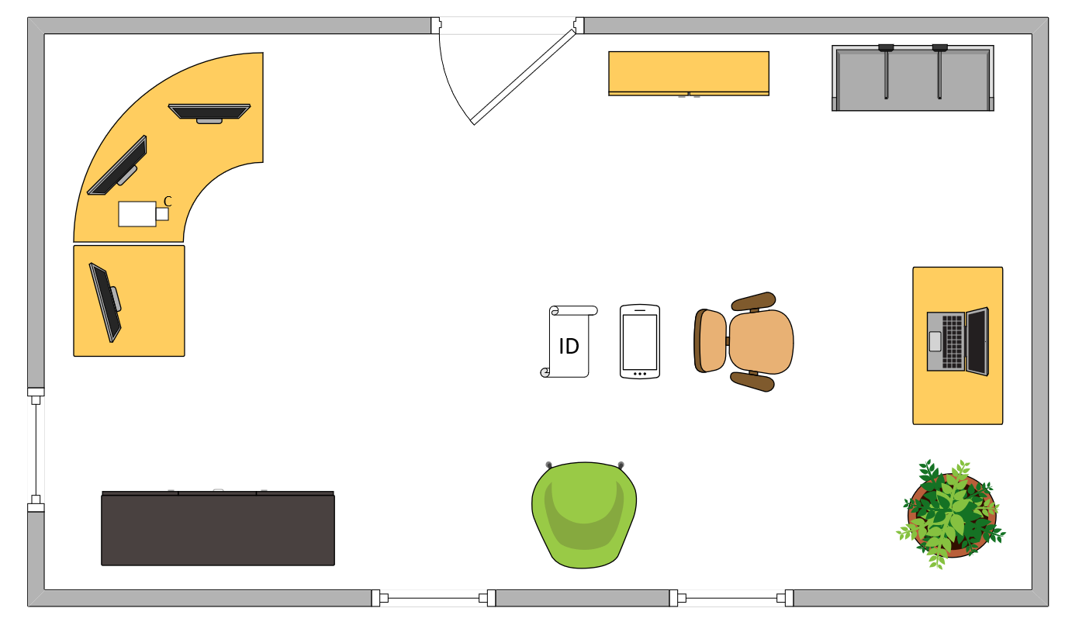

Tim’s Ideal Testing Room
No interruptions or bio breaks
Cover monitors and cameras
Pull back for environment photos
Clear table with laptop

Slide 72
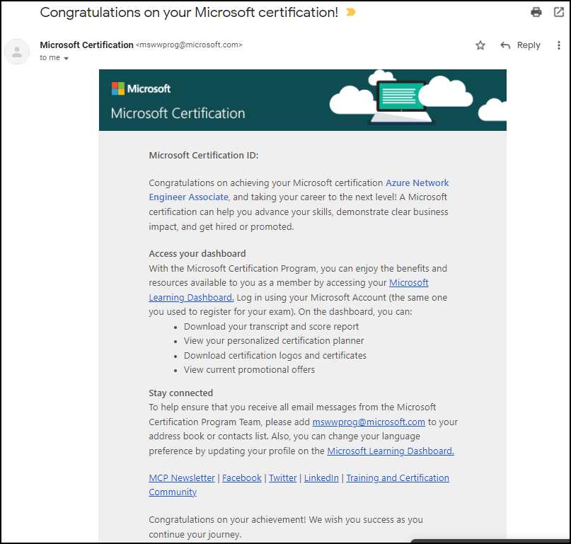
Congratulations!

Slide 73
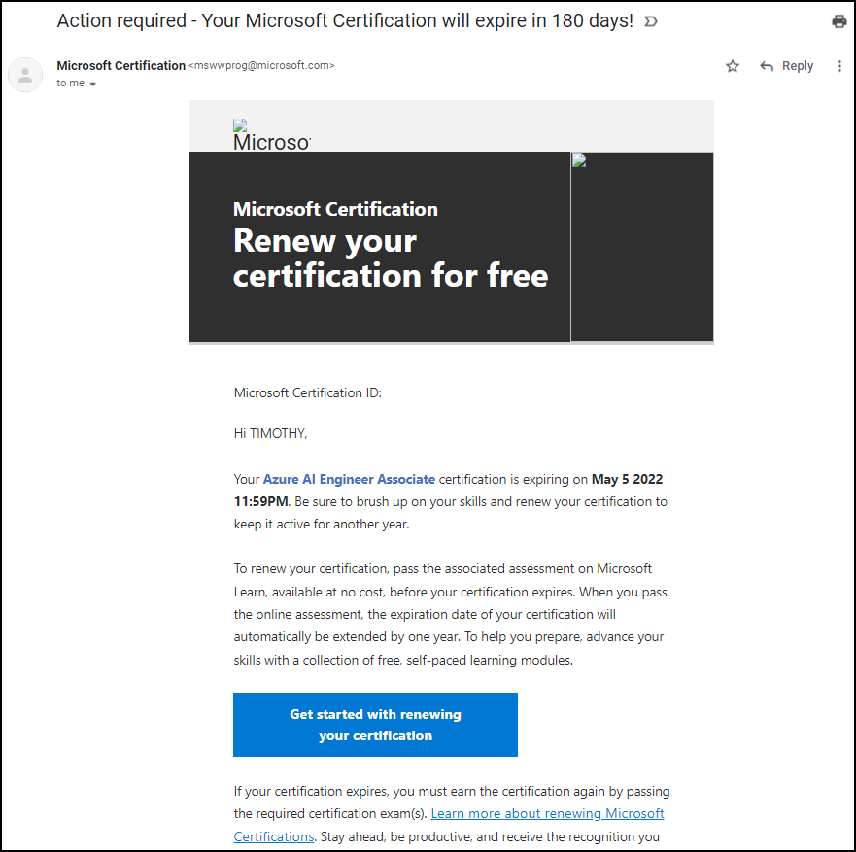
Certification Renewal

